Slide 1

INT 404 – CA 1

Slide 2

SPAM EMAIL DETECTION USING PYTHON

Slide 3

Submitted by:
Name : Venu Tejaswi
Reg no: 12100671
Name : Krishna Sai Manideep
Reg no :12105054
Name: Shanmukh Datta
Reg no :12104966
Submitted to:
Mr.Dipen Saini

Slide 4

Introduction
Spam emails are a major problem for individuals and businesses alike. These unsolicited emails can contain viruses, phishing scams and other harmful content. In order to combat this issue, many email providers have implemented spam filters that automatically detect and filter out unwanted emails. However, these filters are not always effective and some spam emails still manage to slip through.
In this presentation, we will explore how Python can be used to detect and filter out spam emails. We will discuss the different techniques and algorithms used in spam detection, as well as the advantages and limitations of each approach.

Slide 5

PROJECT SCOPE
This project needs a coordinated scope of work. These scopes will help to focus on this project.
The scopes are:
i. Modified existing machine learning algorithm.
ii. Make use and classify of a data set including data preparation,classification and visualization.
iii. Score of data to determine the accuracy of spam detection

Slide 6
Limitations of Spam Detection
The limitation of this project are:
i. This project can only detect and calculate the accuracy of spam messages only
ii. It focus on filtering, analysing and classifying the messages.
iii. Do not block the messages

Slide 7

Machine Learning for Spam Detection
One of the most effective ways to detect spam emails is through machine learning algorithms. Machine learning involves training a model on a large dataset of emails, both spam and non-spam, and using this model to predict whether a new email is spam or not. There are several machine learning algorithms that can be used for spam detection, including Naive Bayes, Support Vector Machines (SVMs),Logistic Regression and Random Forests.
These algorithms work by analyzing the content of an email, such as the subject line, sender, and body text, and looking for patterns that are common in spam emails. By training the model on a large dataset, it can learn to recognize these patterns and accurately classify new emails as spam or not spam.

Slide 8

Content-Based Filtering
Content-based filtering is another technique used in spam detection. This approach involves analyzing the content of an email, such as images and links, to determine whether it is spam or not. For example, if an email contains a link to a known phishing website, it can be flagged as spam.
Content-based filtering can also be used to detect spam emails that contain certain keywords or phrases, such as 'get rich quick' or 'free money'. By analyzing the content of an email, these keywords can be identified and the email can be flagged as spam.

Slide 9
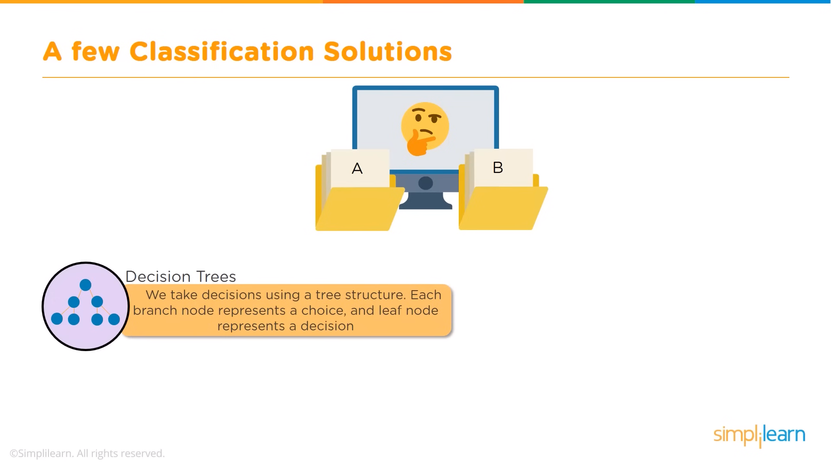

Slide 10
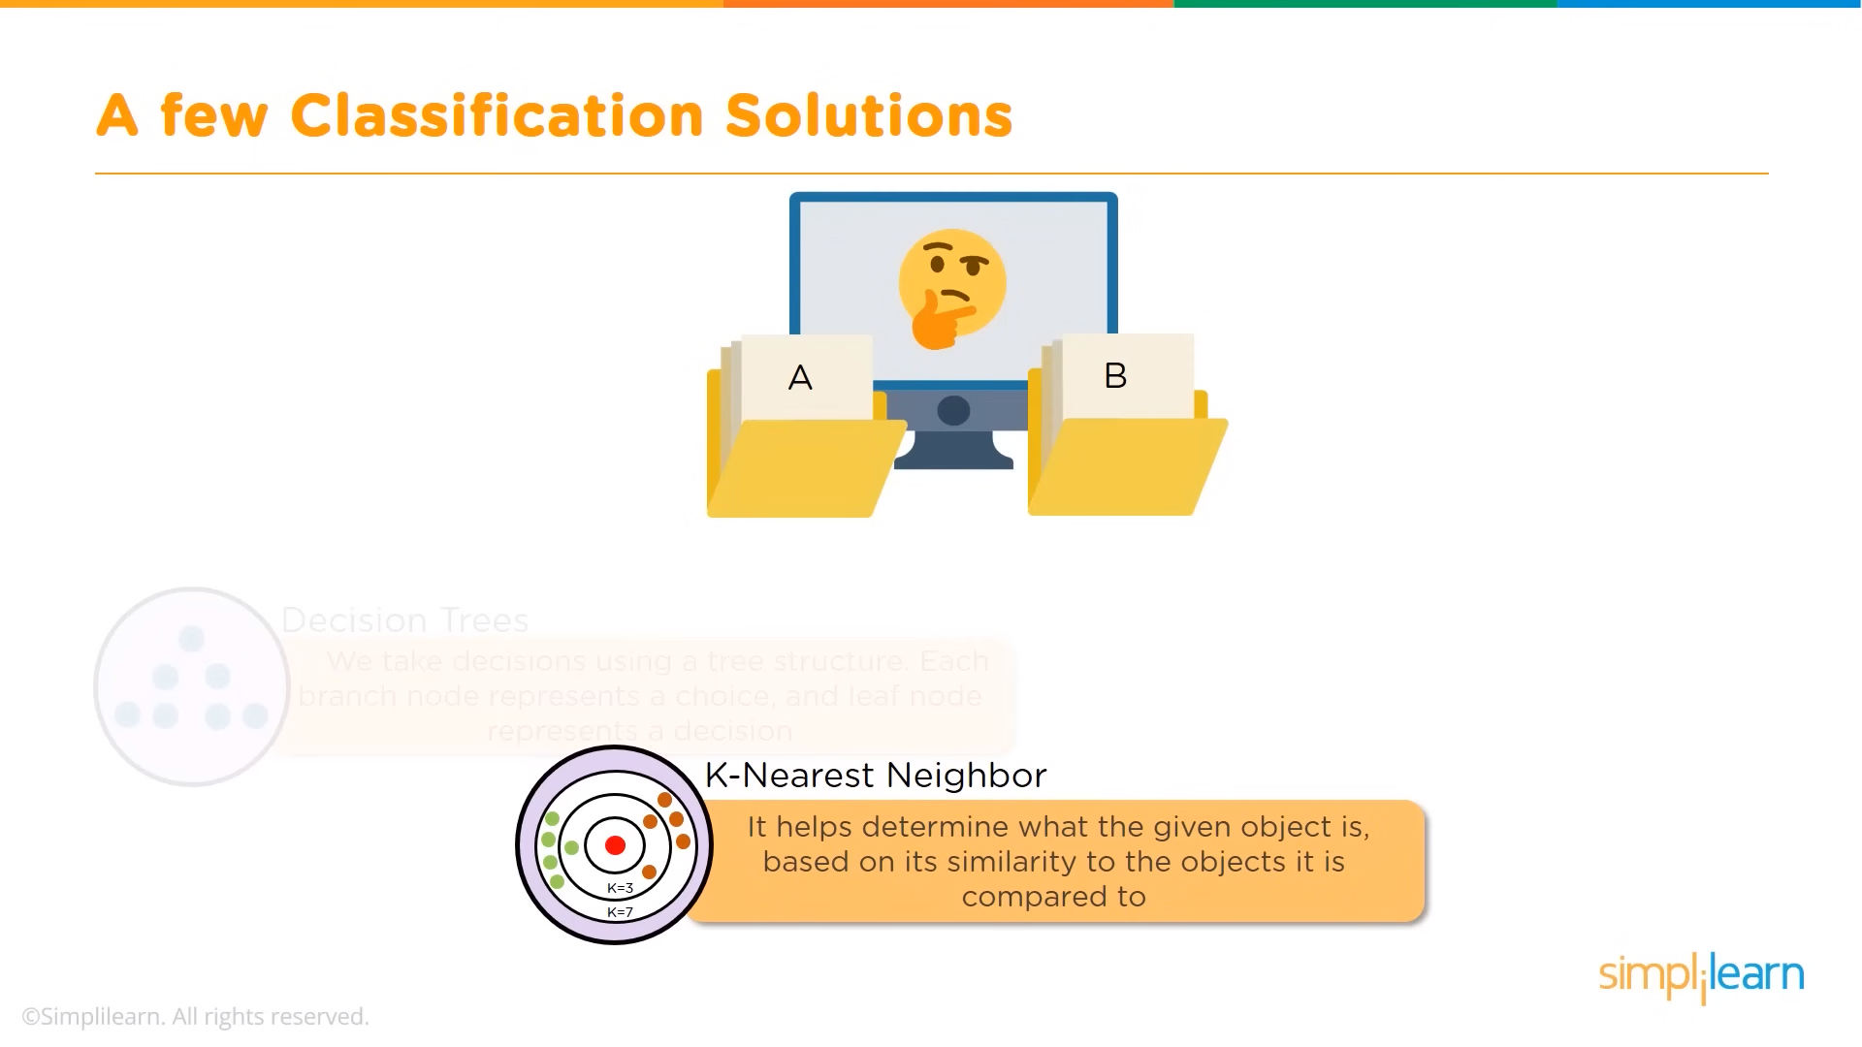

Slide 11
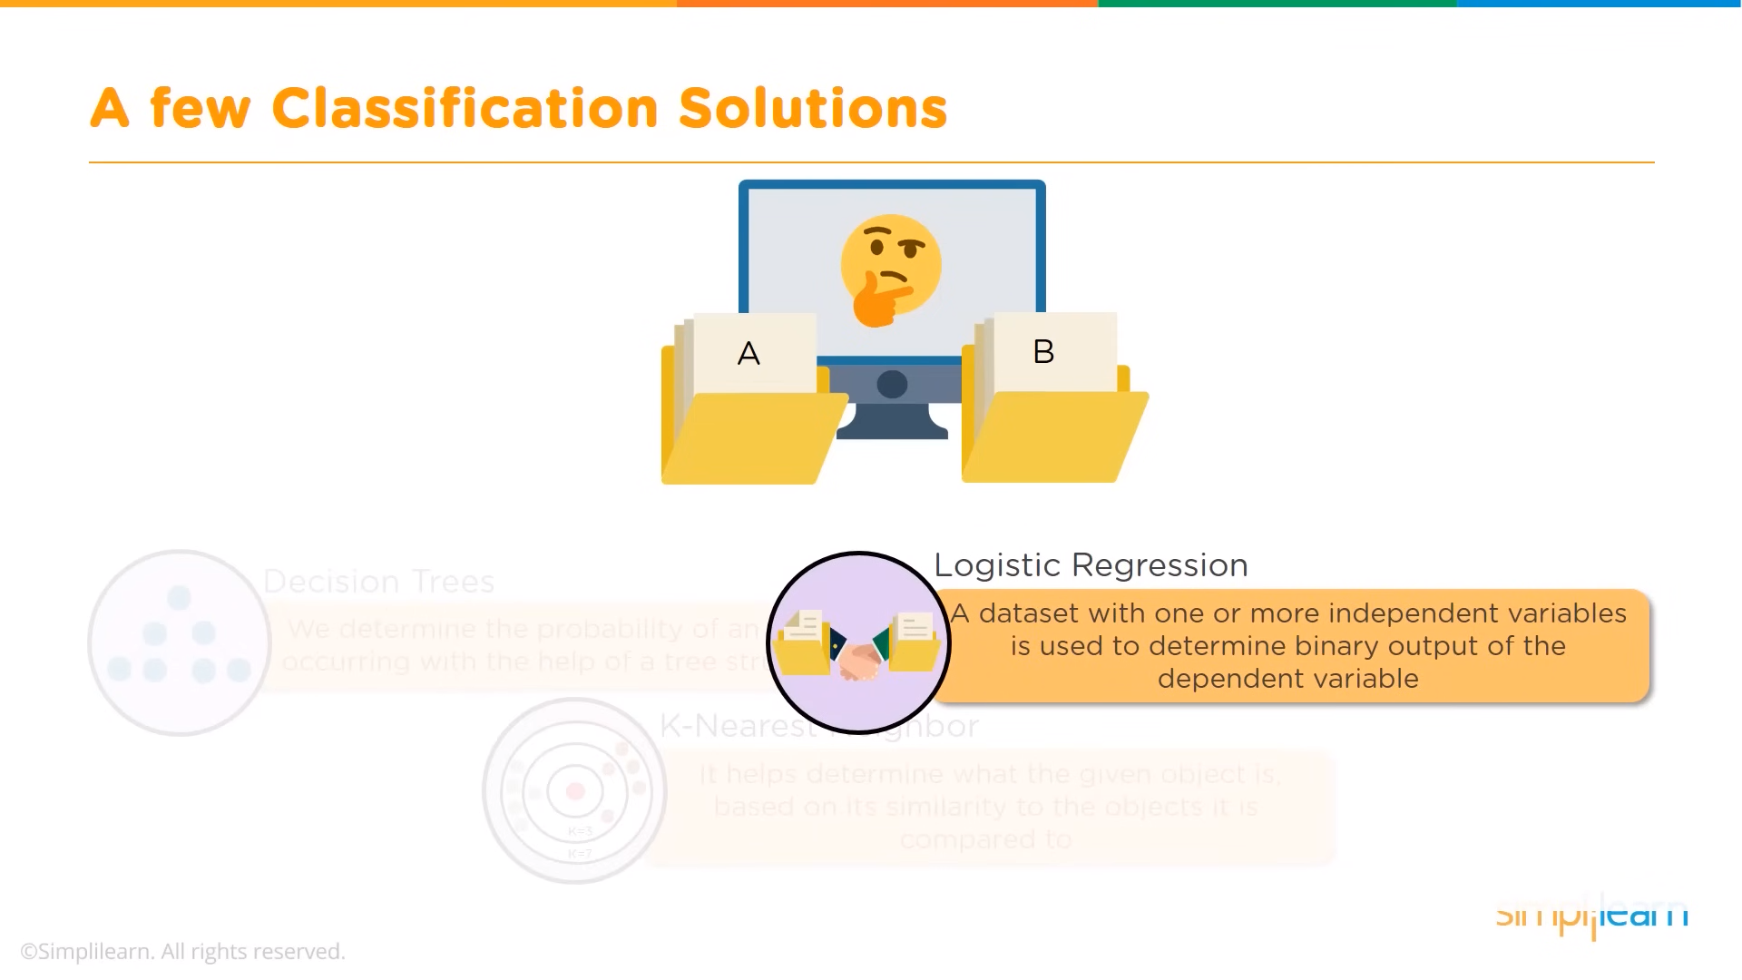

Slide 12

LOGISTIC REGRESSION :
Generally when someone asks, what is logistic regression? what do you tell them — Oh! it is an algorithm which is used for categorizing things into two classes (most of the time) i.e. the result is measured using a dichotomous variable. But, how does logistic regression classify thing into classes like -binomial(2 possible values), multinomial(3 or more possible values) and ordinal(deals with ordered categories)

Slide 13
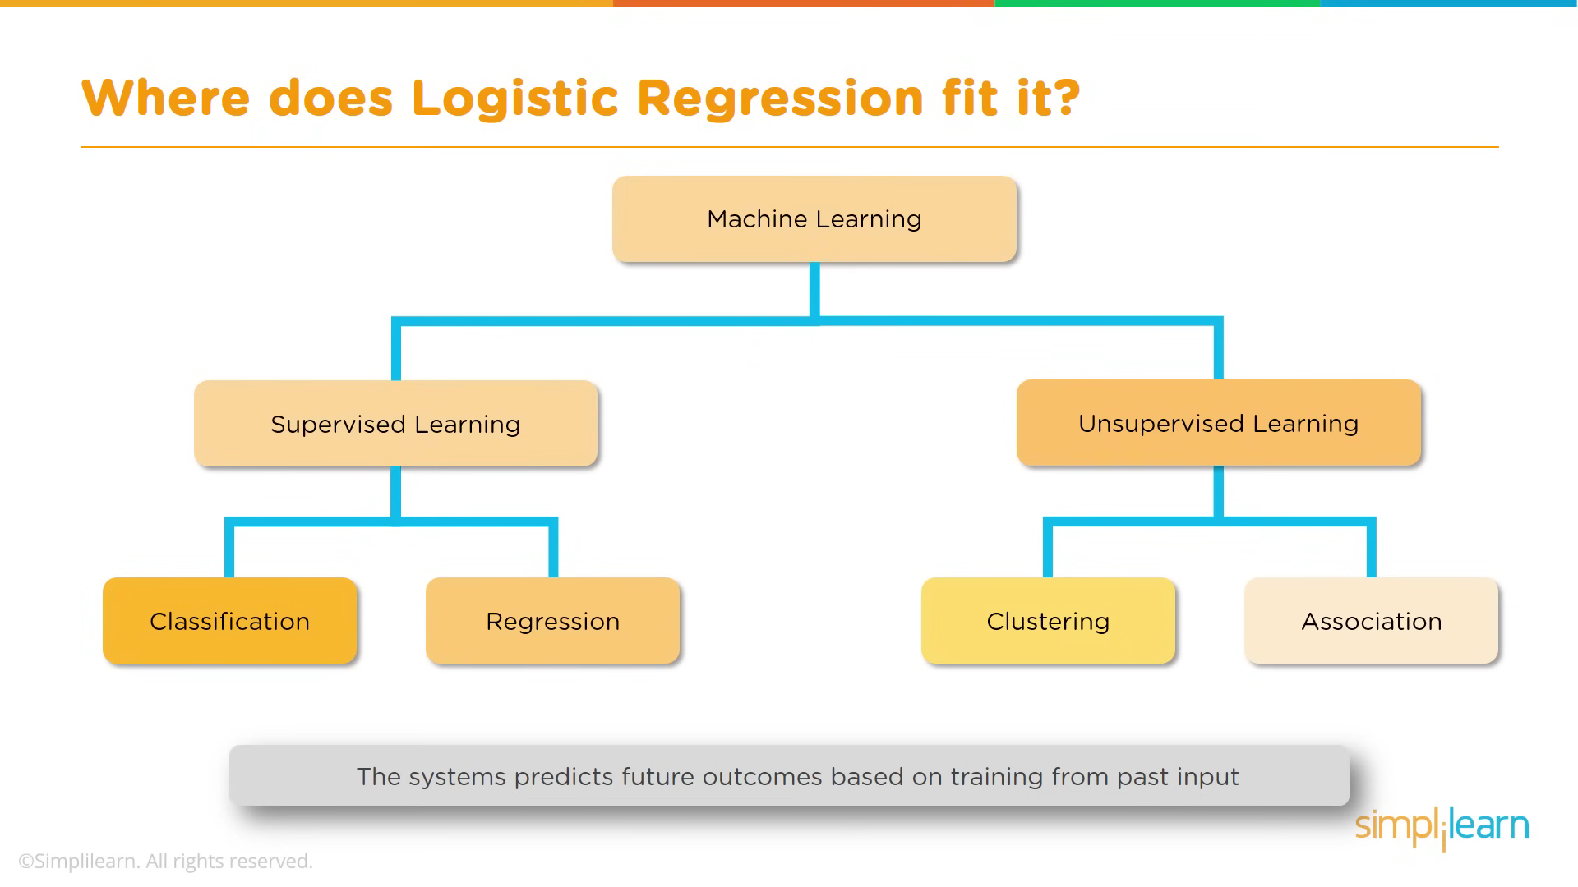

Slide 14
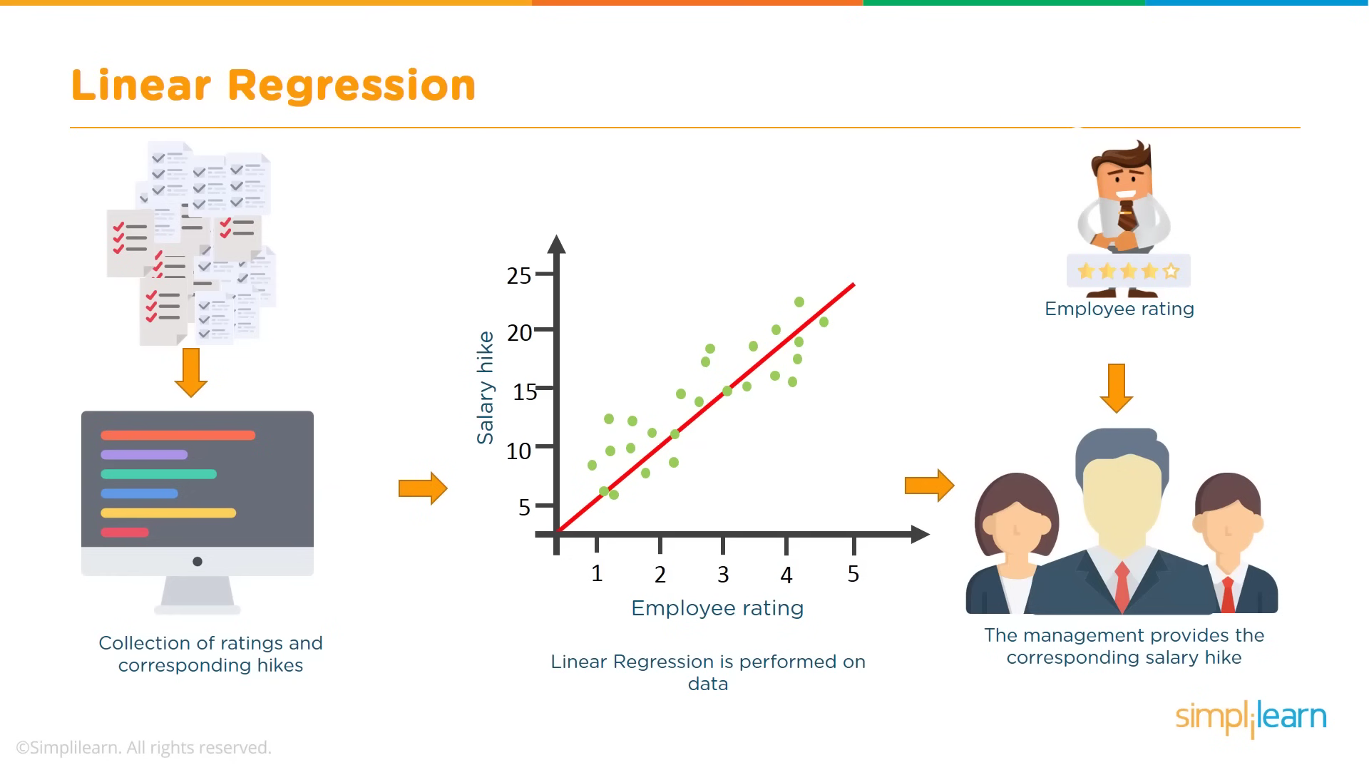

Slide 15
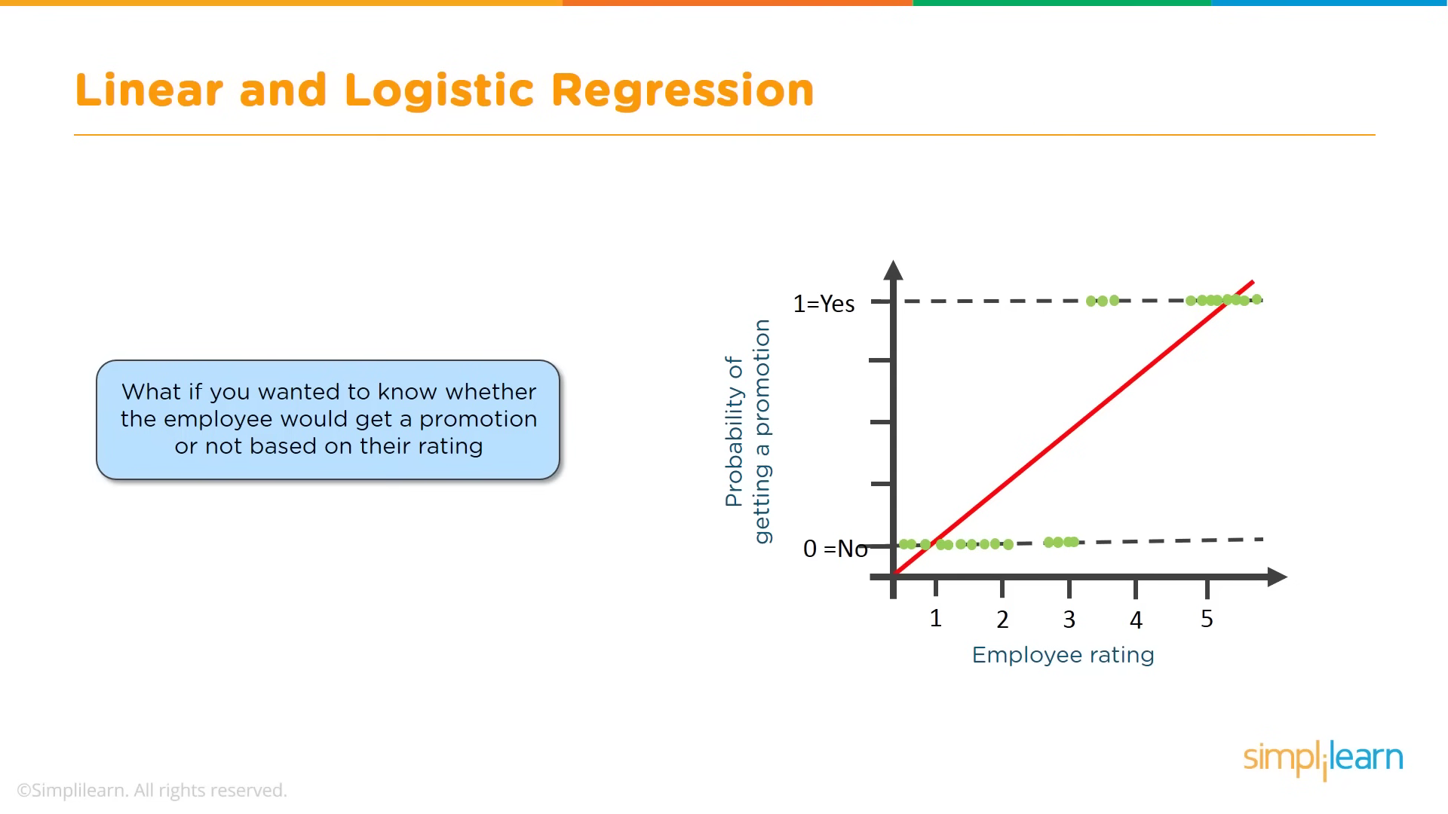

Slide 16
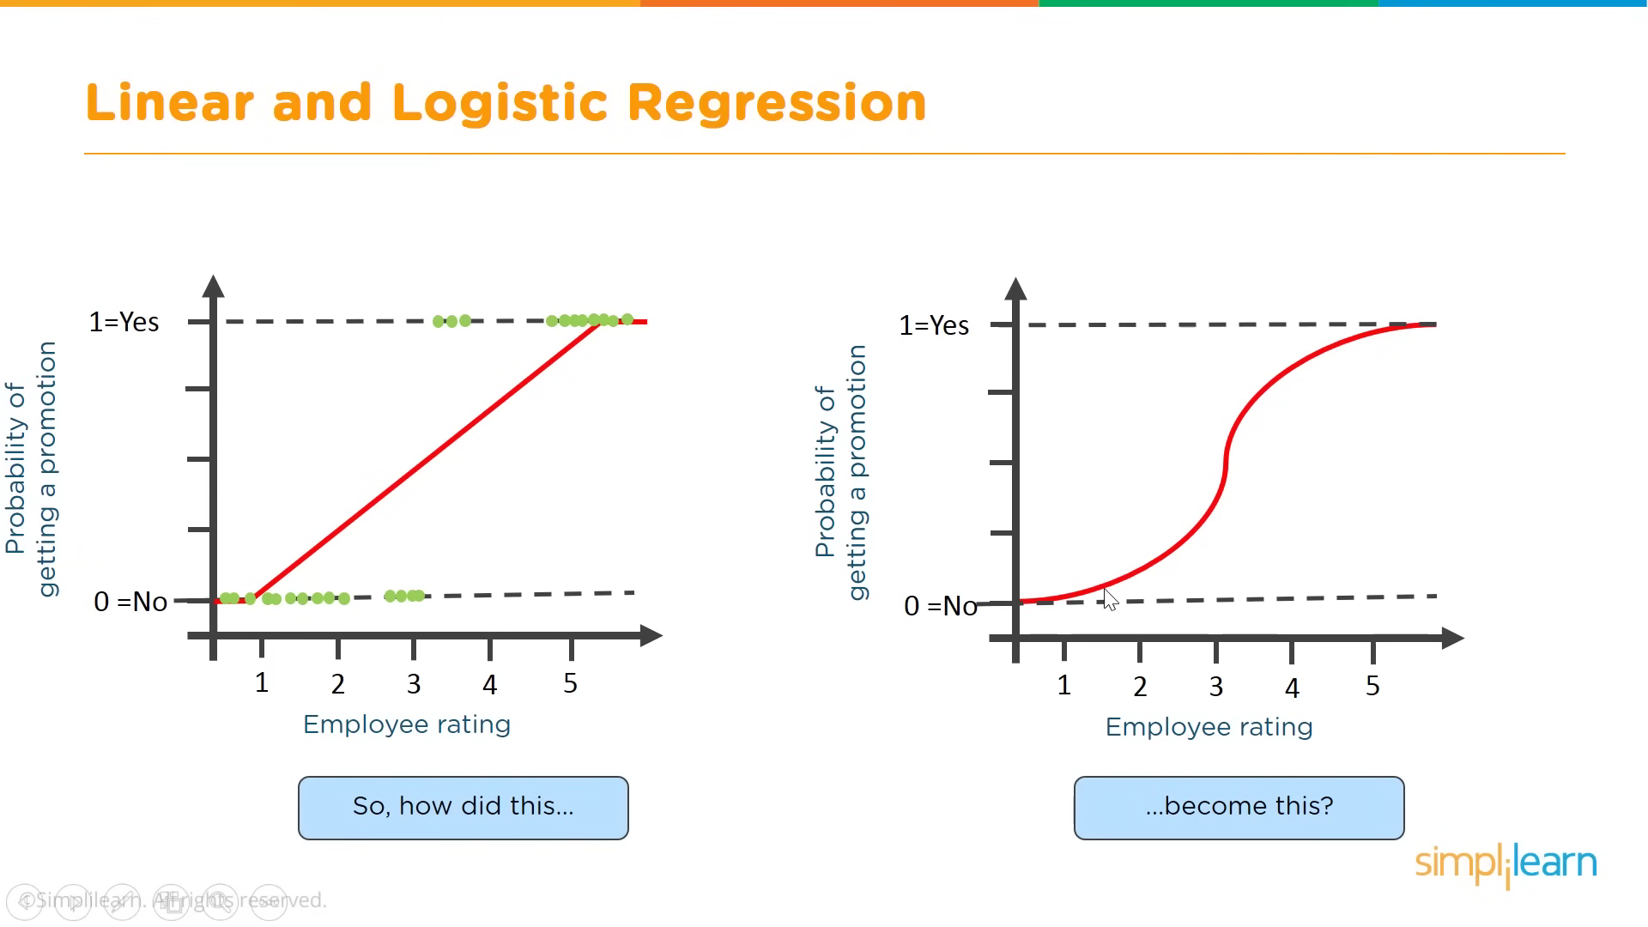

Slide 17
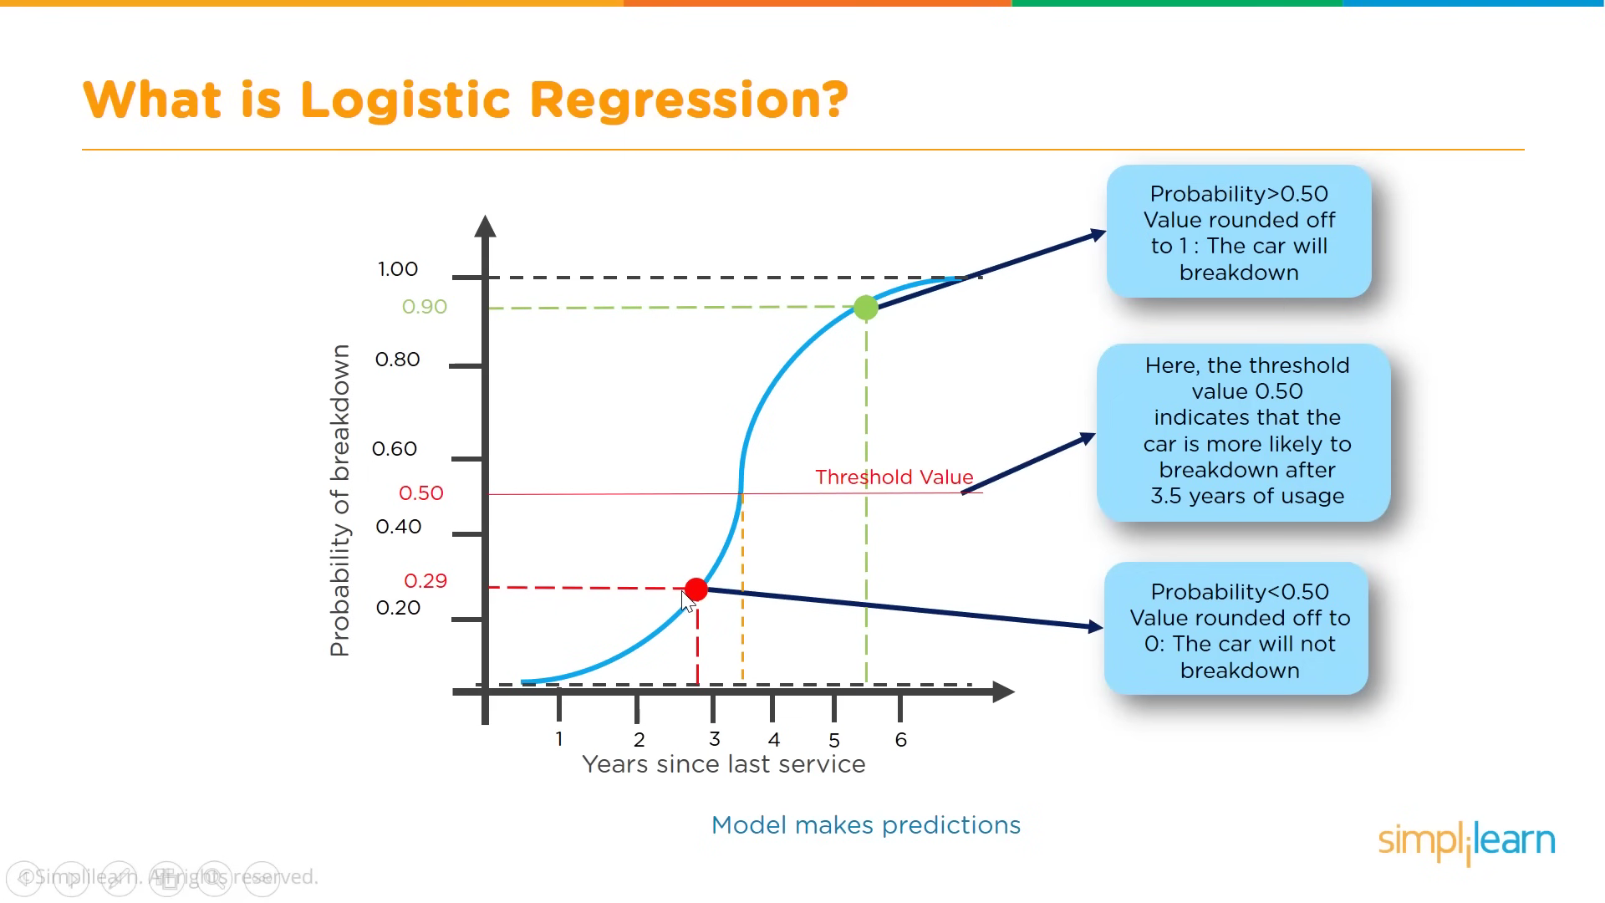

Slide 18
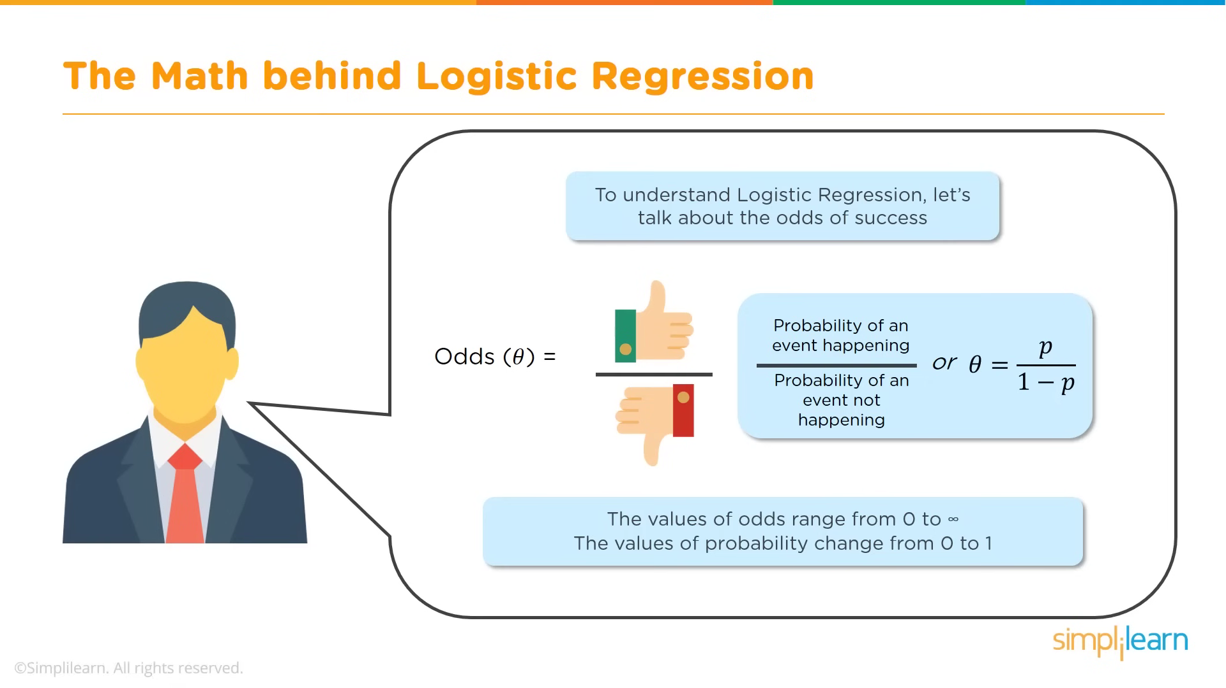

Slide 19
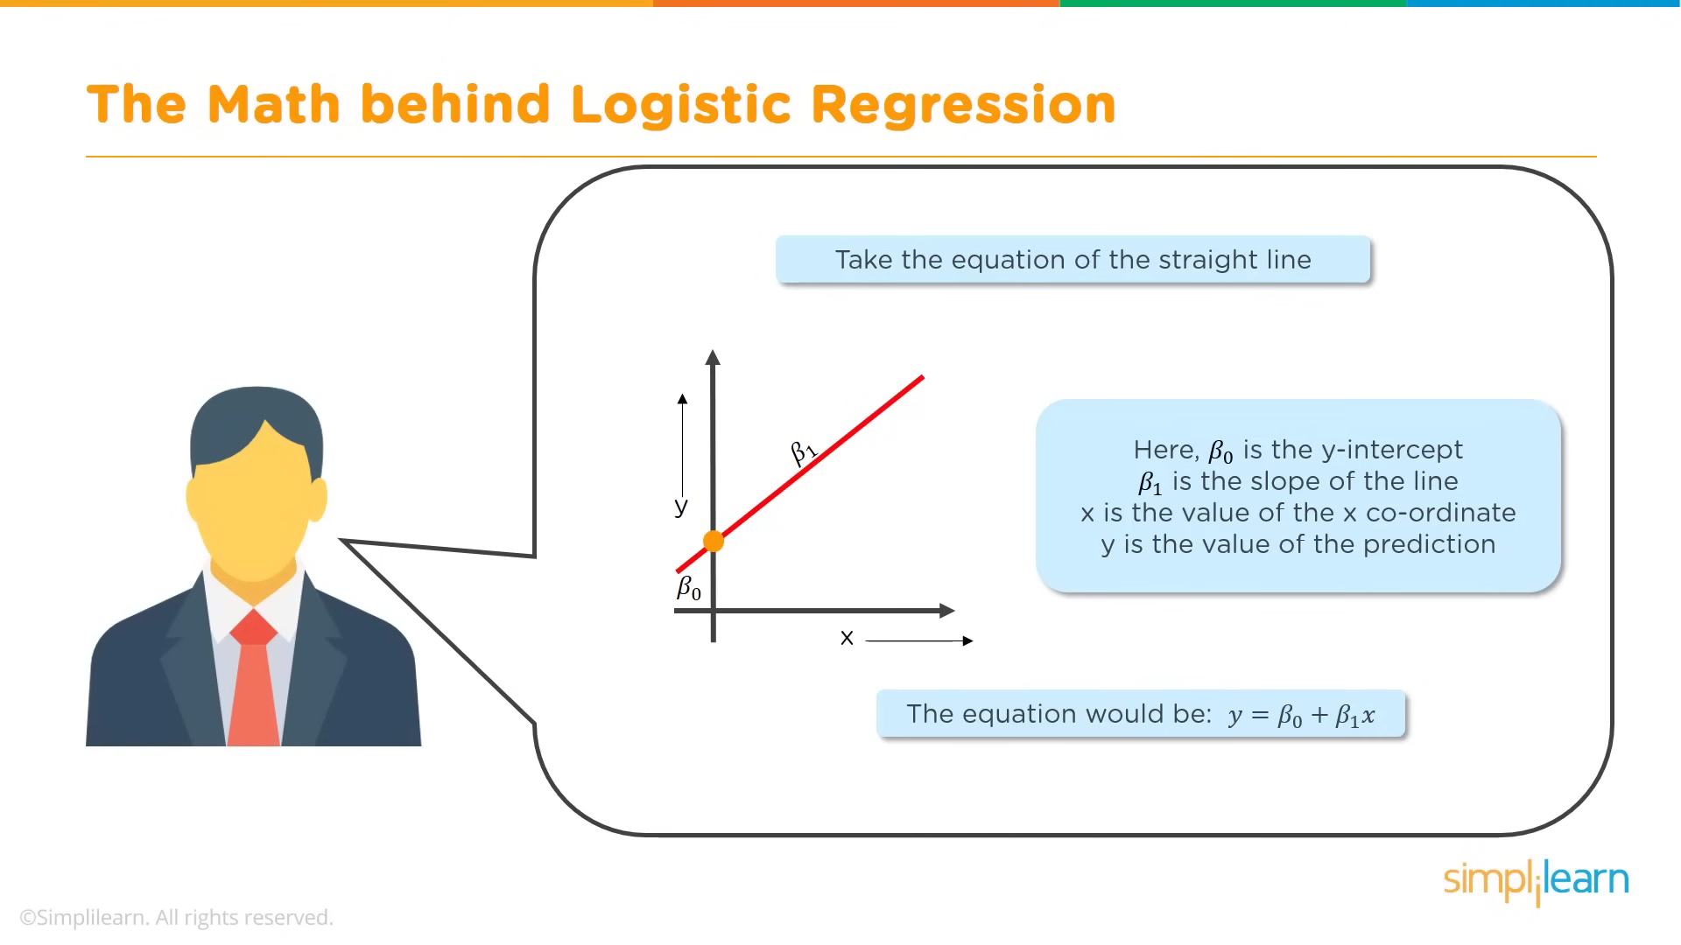

Slide 20
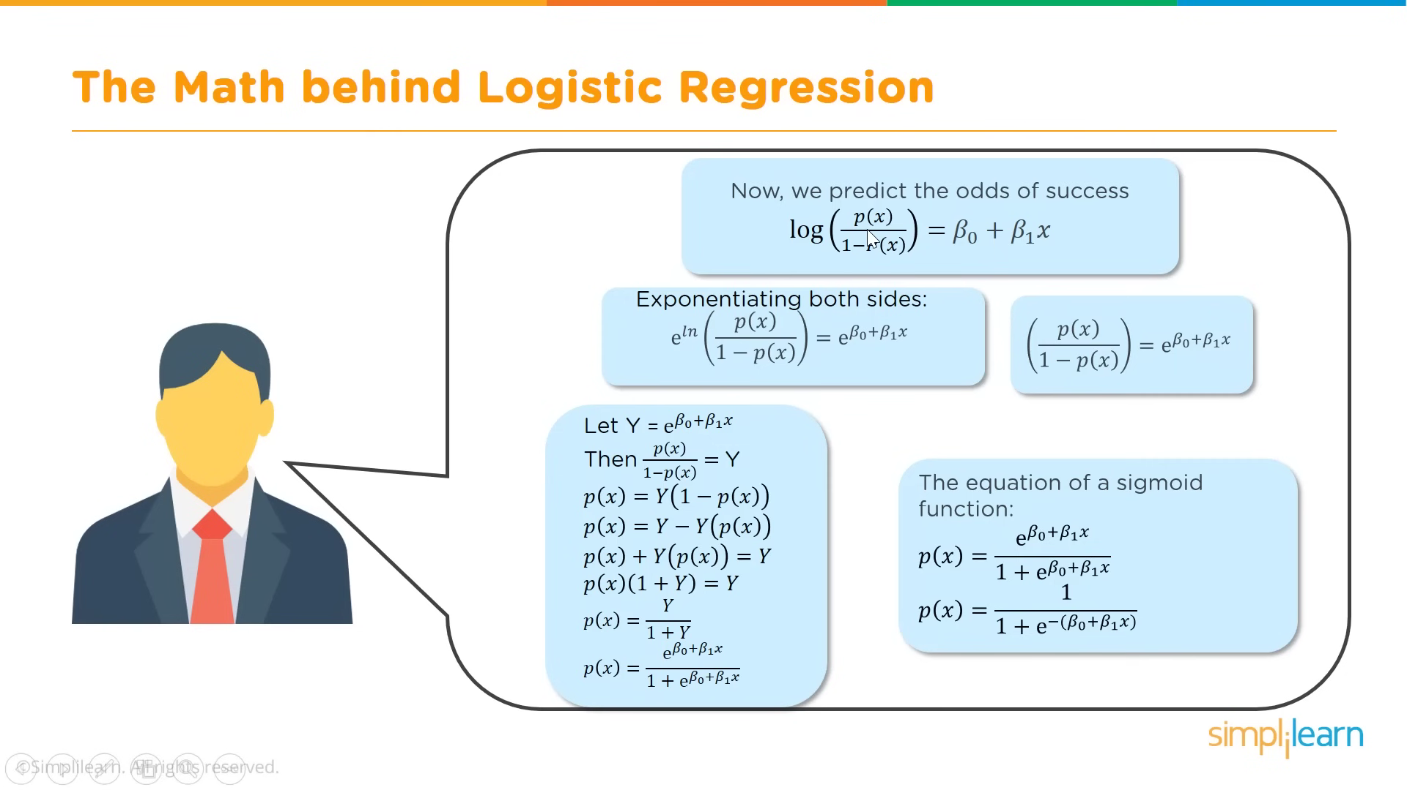

Slide 21
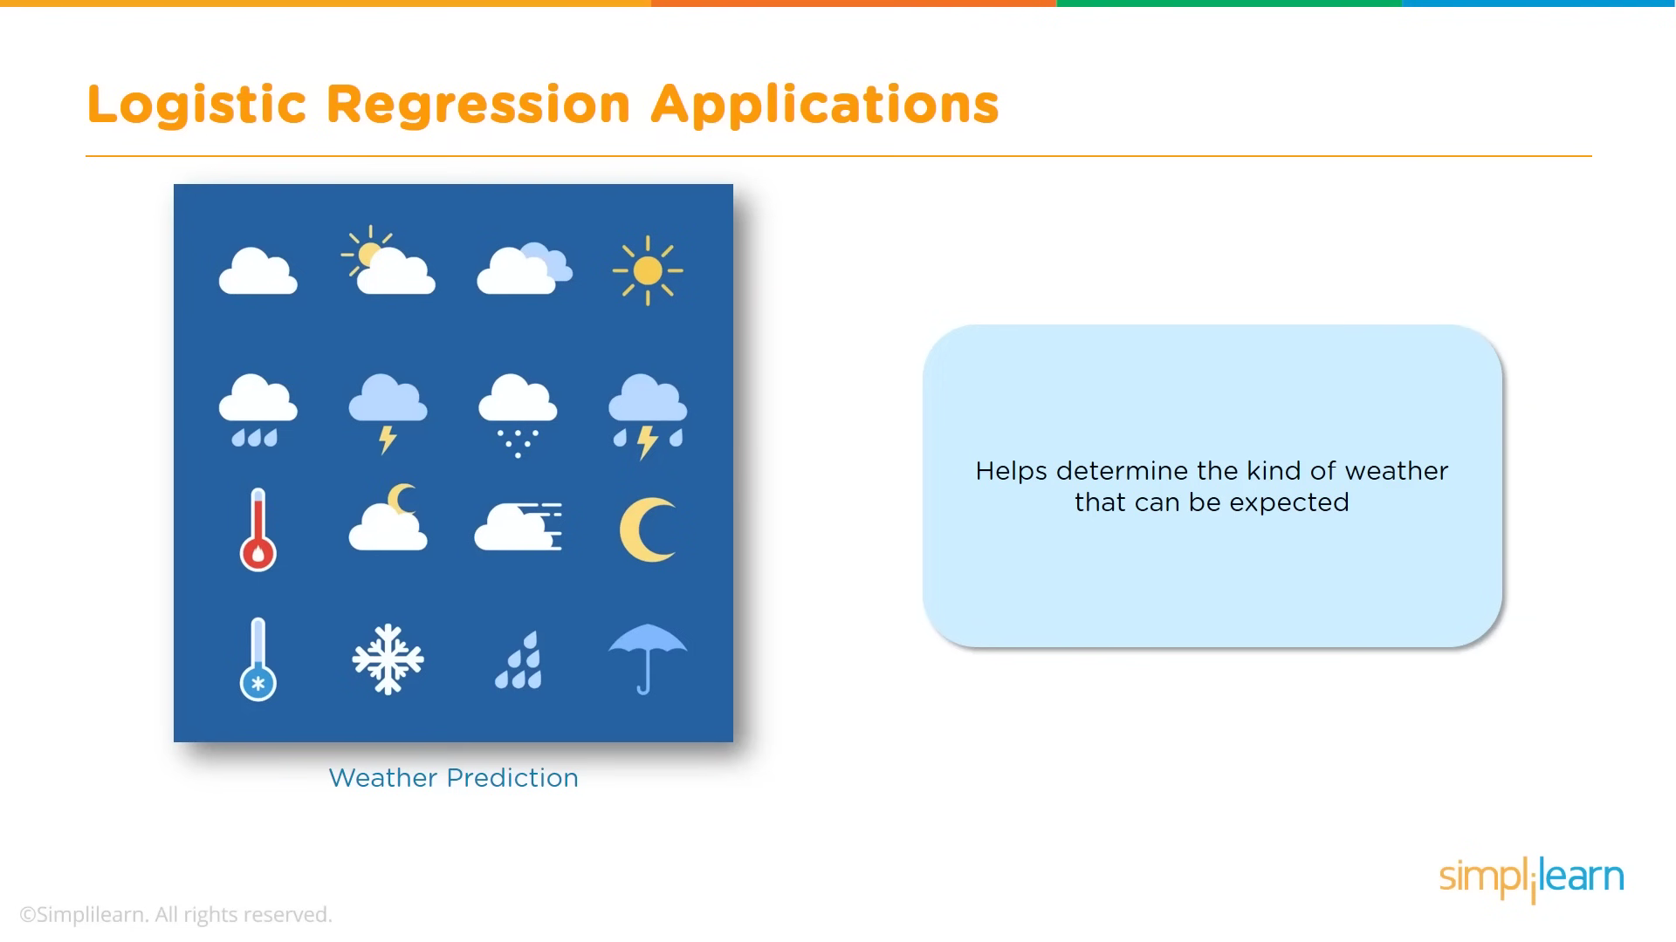

Slide 22
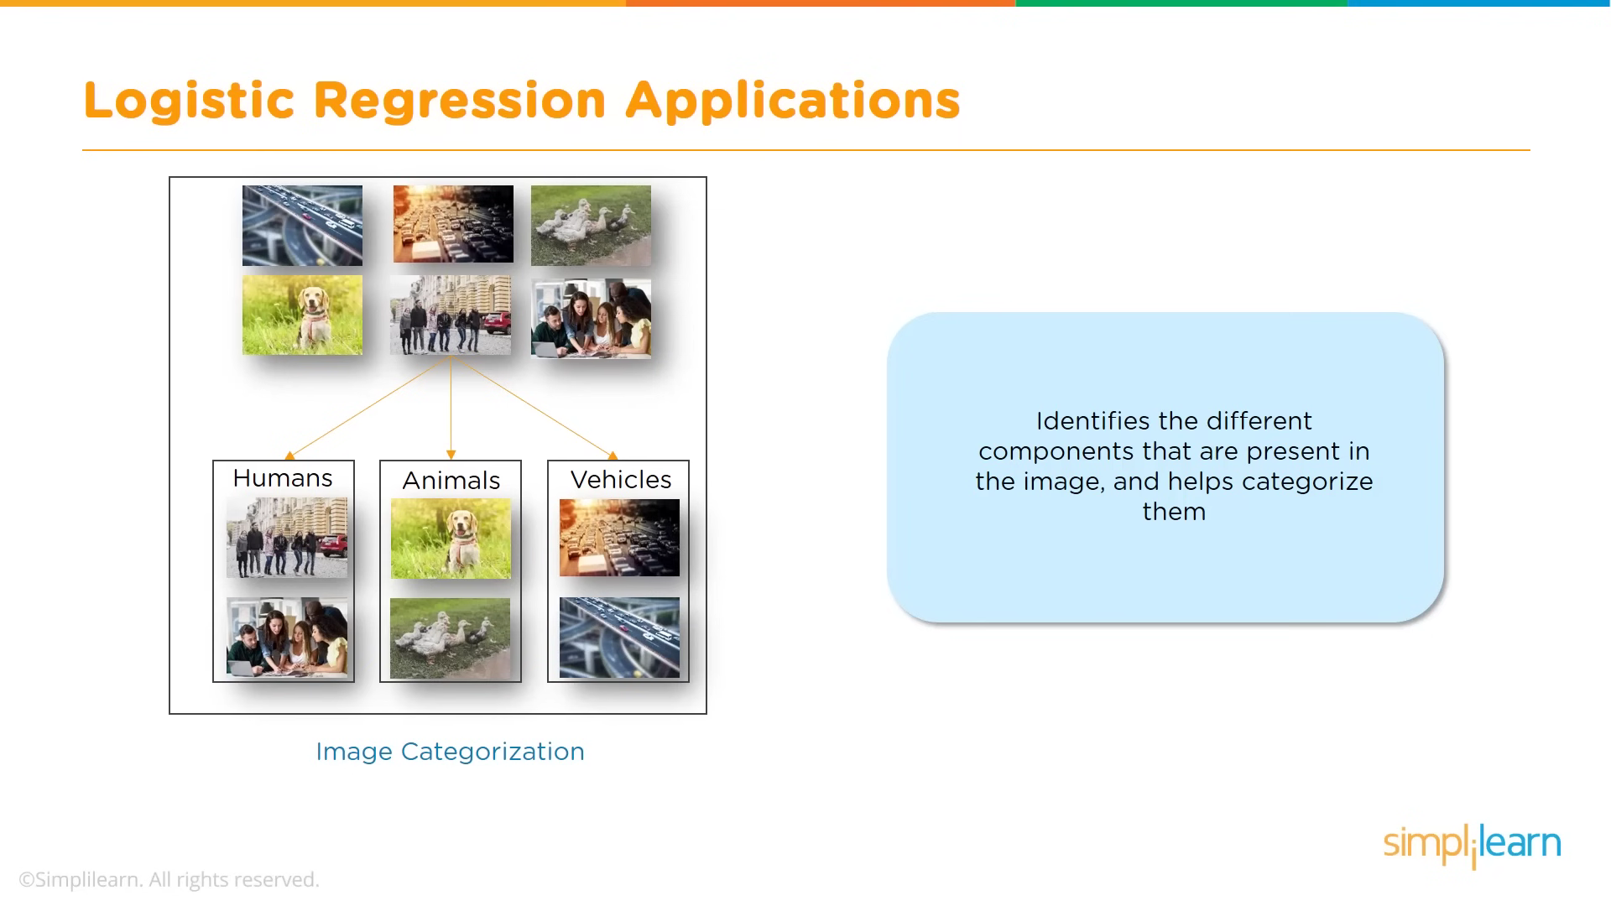

Slide 23
Used Libraries
1.numpY
2.pandas
3.sk-learn

Slide 24

1.numpy:
It is the fundamental package for scientific computing with Python . Besides its obvious scientific uses, numpy can be used as an efficient multi-dimensional container of generic data.
2.pandas:
Pandas is an open-source library that is made mainly for working with relational or labeled data both easily and intuitively. It provides various data structures and operations for manipulating numerical data and time series. This library is built on top of the NumPy library. Pandas is fast and it has high performance & productivity for users.
3.Sk-learn:
Scikit-learn is an open-source Python library that implements a range of machine learning, pre-processing, cross-validation, and visualization algorithms using a unified interface.

Slide 25
Conclusion
In conclusion, spam email detection is an important issue that affects individuals and businesses alike. While there are many techniques and algorithms used in spam detection, it is important to remember that no system is perfect. By combining multiple approaches, such as machine learning and content-based filtering, it is possible to create a more effective spam filter.
Python provides a powerful toolset for implementing these techniques and creating custom spam filters. With its ease of use and extensive libraries, Python is an ideal language for developing spam detection systems

Slide 26

Thank YOU

